Slide 1
What is Service Oriented Architecture (SOA)?
SOA is an architecture pattern for developing distributed systems where the system functionality is developed, deployed and utilised as stand-alone software services.
Three building blocks of SOA
- Service Provider
- Service Requester
- Service Publisher
Typical Examples
- Weather Reporting Service
- Currency Conversion Service
- Language Translation Service
- Video Streaming Service
Service Publisher
Subscribe
Publish
Software Services
Service Requester
Service Provider
Bind

Slide 2
Service Oriented Architecture (SOA)
Service consumer expresses “intent”
Service providers define “offers”
Sometimes a mediator will:
Find the best offer matching an intent
Service Publisher
Publish
Software Services
Service Requester
Service Provider
Bind

Slide 3
SOA – alternative terminologies
Rental Agency
Service
registry
Apartment(size,
immediate, cheap)
lookup
publish
Property Details
Service
requestor
Service
provider
bind
Tenant
Property Owner
Rental Agreement

Slide 4
Software Services
A Software Service can be defined as:
a loosely-coupled, reusable software component that encapsulates functionality which may be distributed and programmatically accessed.
a set of related software functionalities that can be reused for different purposes, together with the policies that should control its usage.
A Web Service can be defined as:
as a service that is published and accessed using standard Internet and XML-based protocols.
Mainframe
Client Server
World Wide Web
SOA

Slide 5
Key Aspects of Software Services
Services can be discovered
Services can be composed to form larger services
Services adhere to a service contract
Services are loosely coupled
Services are stateless
Services hide their logic
Services are reusable
Services use open standards
Services facilitate interoperability

Slide 6
Object vs Service (Object-Orientation vs Service Orientation)
Service
User Login
User Registration
Provider Interface
ID
Name
isRegistered
UserLogin
uses
- getID()
- getName()
- LoginStatus()
- RegStatus()
Requester Interface
Object Classes

Slide 7


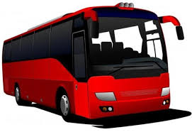


Service-Orientation in Real World
Our society has become what it is today through the forces of
Specialisation
Standardisation
Scalability
It is now almost exclusively “service” oriented
Transportation
Telecommunication
Retail
Healthcare
Financial services

Slide 8
Service-Orientation: the Restaurant Analogy
Restaurant provides food: a service
After the order is taken, food is produced, served, …: service may consist of other services
The menu indicates the service provided: a service description
The order is written down, or yelled at, the cook: services communicate through messages

Slide 9
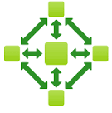
SOA based on Web Services
SOA is a means of developing distributed systems where the components are stand-alone services.
Services may execute on different computers from different service providers.
Web Server
Document for Translation
Translation Services

Slide 10
Service-Oriented Software service Engineering Process
Service
Service
candidate
Service design
implementation
identification
and deployment
Service
Service interface
V
alidated and
requirements
specification
deployed service

Slide 11
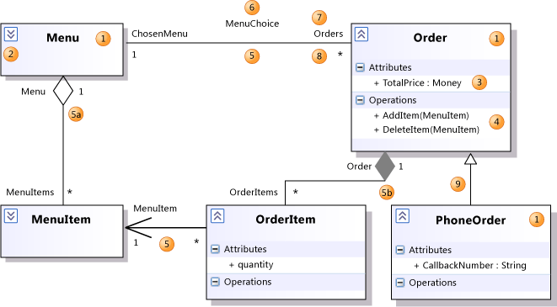
Models in Software Engineering
Model-driven engineering (MDE) is a software engineering methodology which focuses on creating and exploiting domain models, which are conceptual models of all the topics related to a specific problem. [Wikipedia]
Model Driven Engineering, MDE for short, aims to raise the level of abstraction in program specification and increase automation in program development.

Slide 12
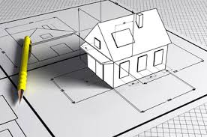
What Exactly is a Model?
A model is an abstract representation of a product, service or system that allows us to investigate, verify and document its properties before production

Slide 13
Model-driven Engineering vs Model-driven Development
Engineering vs Development?
Model Driven Development aims to exploits the models to implement a software system
Model Driven Engineering aims to exploits the models to represents the system requirements and design for system implementation and its evaluation
Requirements
Design
Implementation
Evaluation
Models

Slide 14
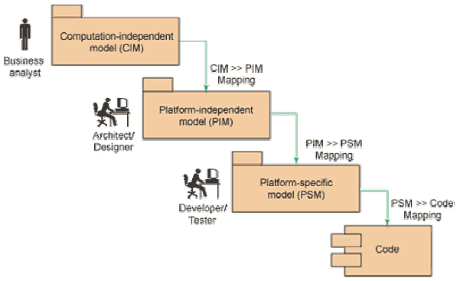
Types of Models
Abstraction
Implementation

Slide 15
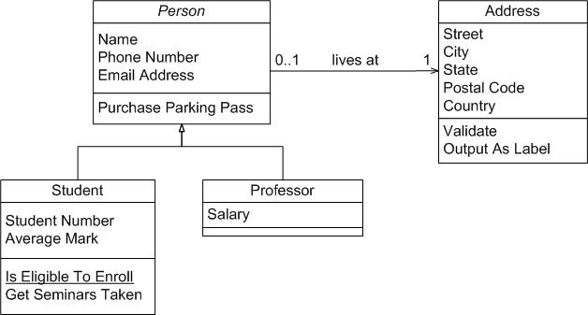

Tools and Technologies for MDSD
Eclipse Modeling Framework (EMF) is an
Eclipse-based modeling framework and code generation facility for building tools and other
applications based on a structured data model.

